Slide 1

PROJECT PRESENTATION
Database Systems Project Presentation
Presented by: Group Oracle

Slide 2





Team Introduction
Ali Huseynov
Ahmet Yusuf Kurukız
Fronted / Backend Operations and UI Views
Countries Table
Backend Operations
Indicators Table
Devrim Polat
Backend Operations,
Economy Indicators Table
Mehmet Fatih Kaya
Frontend Operations and UI Views, Education Indicators Table
Yunus Korkmaz
Database Management,
Health Indicators Table

Slide 3
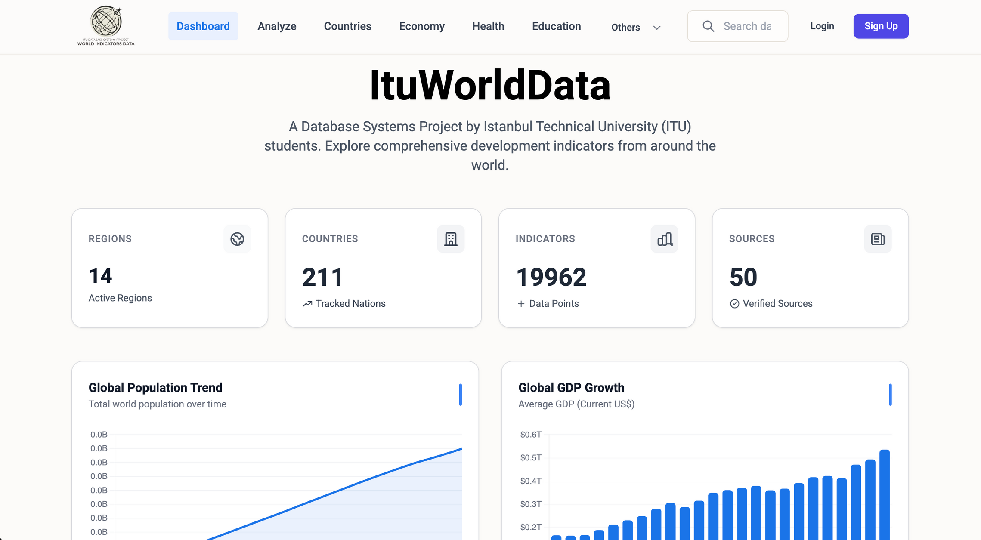
Overview

Slide 4
Motivation and Goals
Normalization: To design a 3NF schema that ensures data consistency
Security: To implement a "Strict Admin Approval System" where new users must be explicitly approved by an Admin before accessing the data
Insight: To transform raw static data into dynamic, comparative time-series visualizations
Data Fragmentation: Critical global data is scattered across disparate sources (World Bank, WHO, UNESCO), making cross-domain analysis impossible
Redundancy: Traditional flat-file storage leads to massive data duplication and update anomalies.

Slide 5
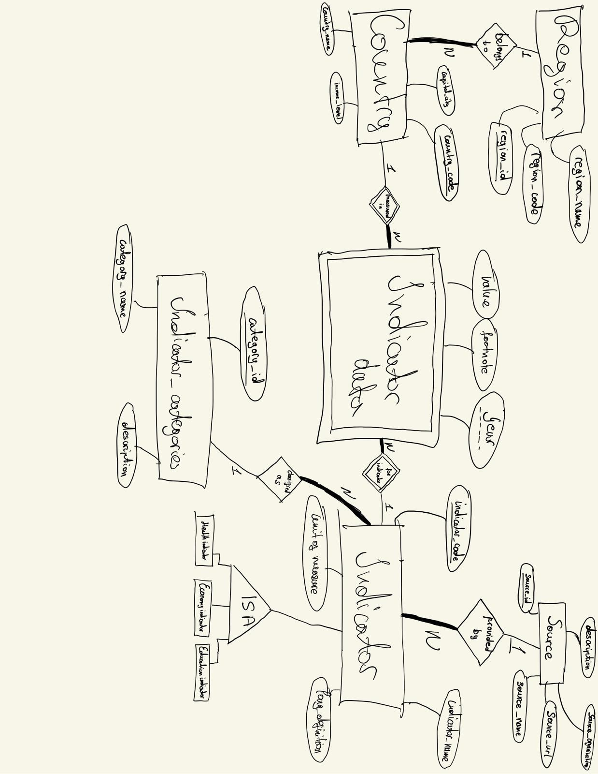
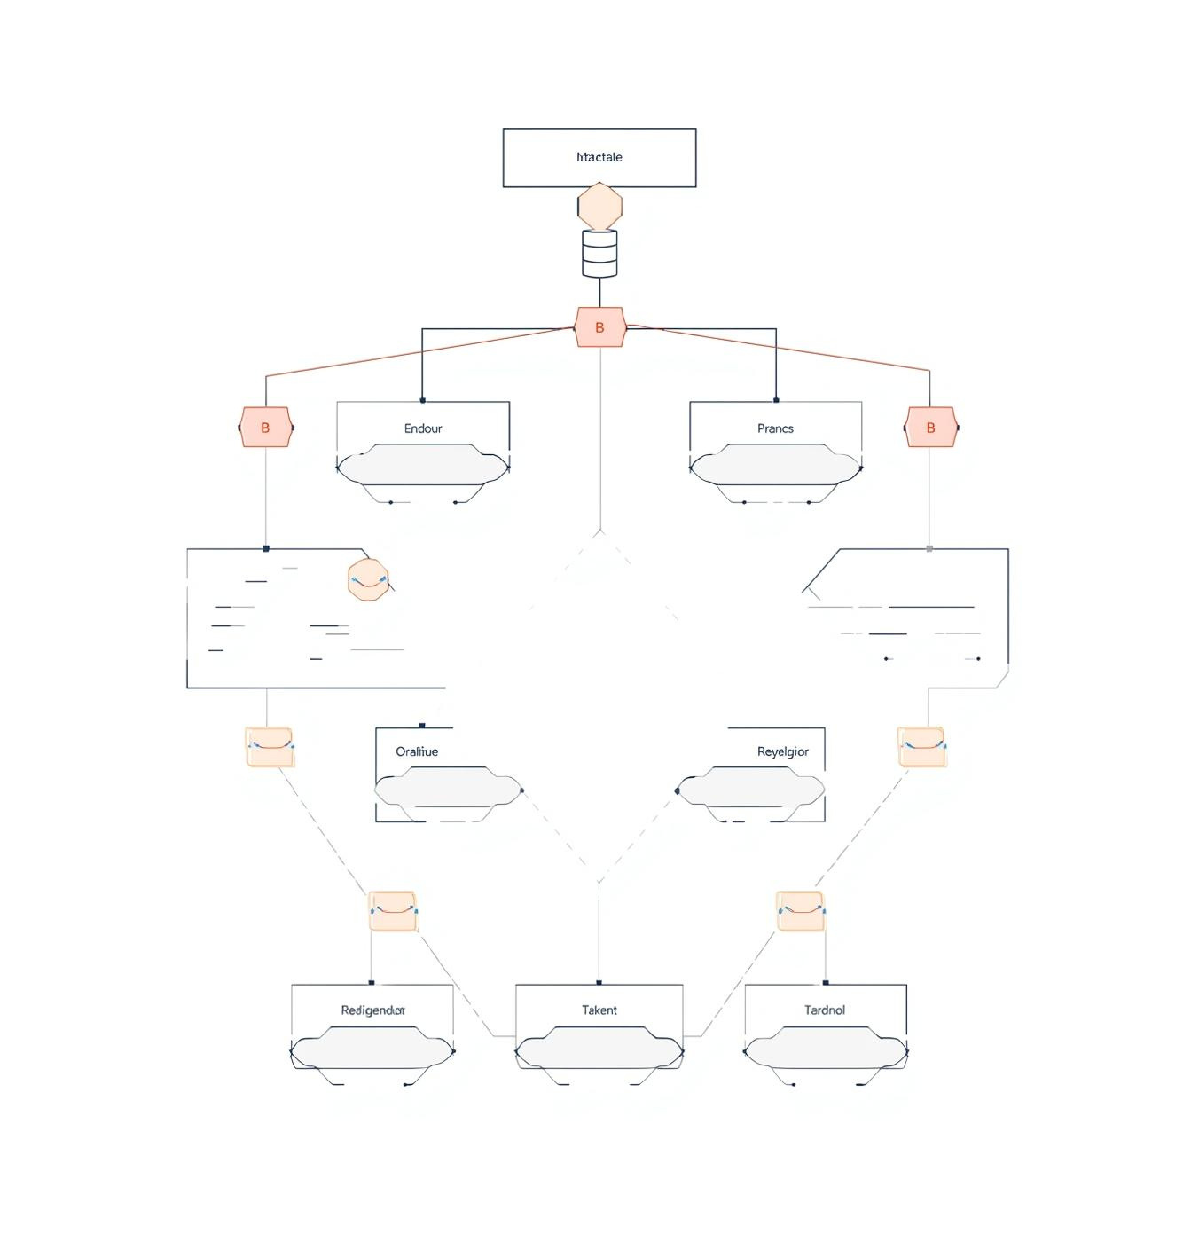
ER Diagram

Slide 6
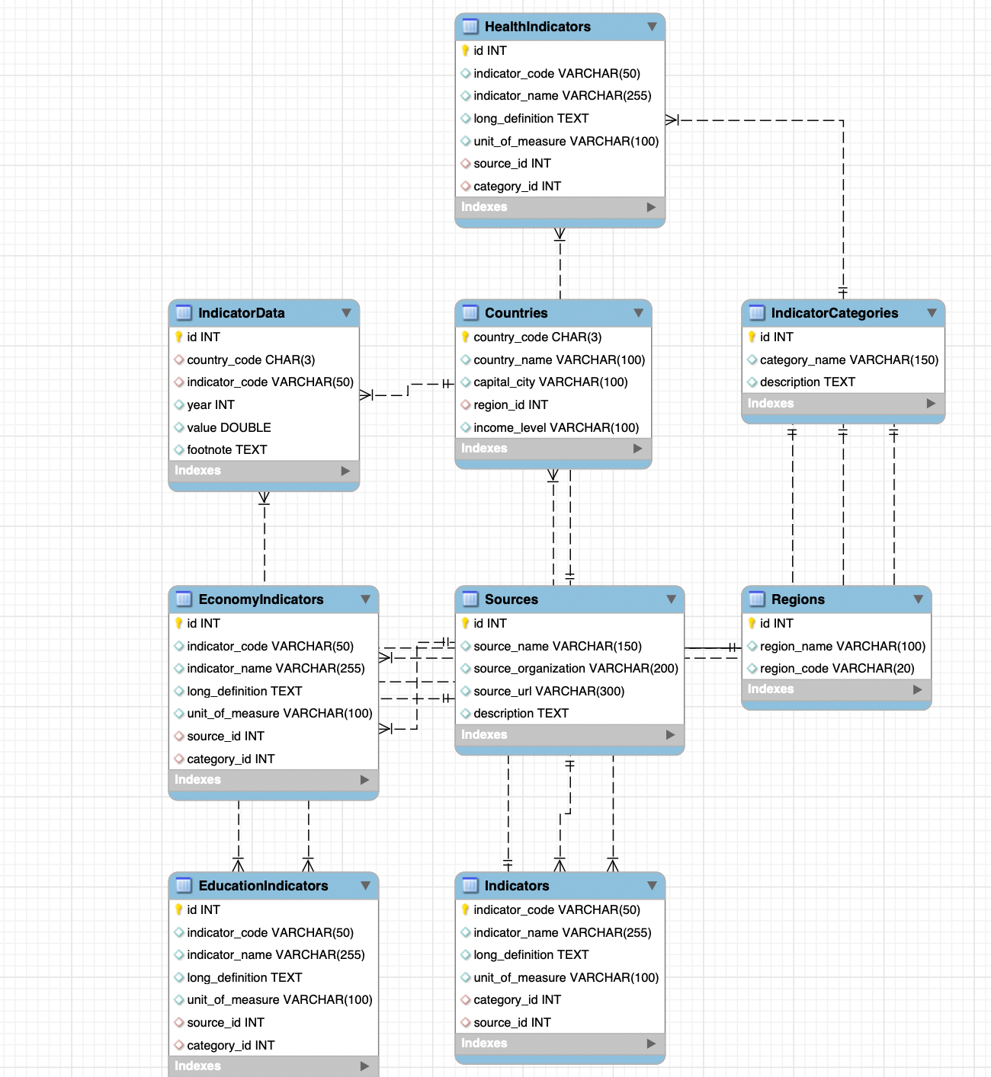
ER-to-Relational Mapping:

Slide 7
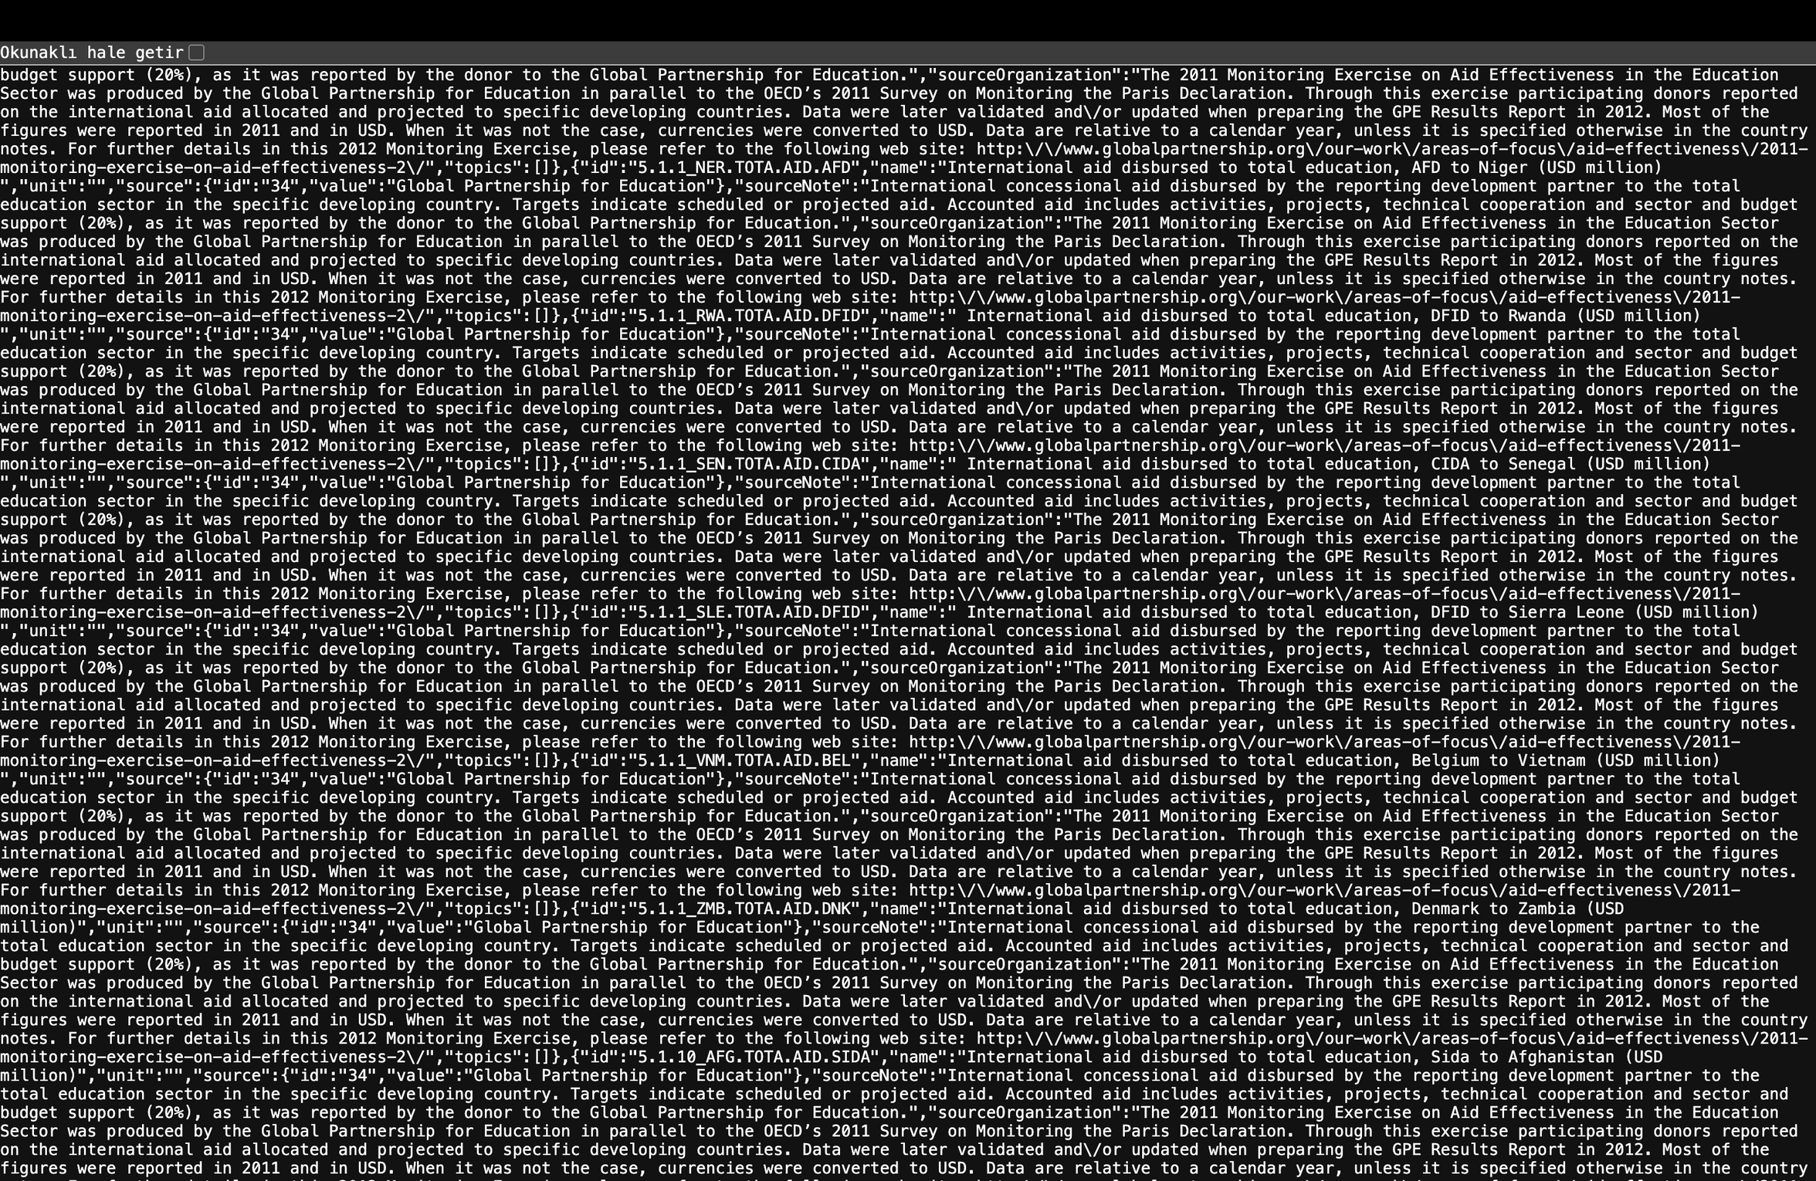
Before Normalization
Before Normalization: Raw JSON
Input: Raw API response in nested format.
Redundancy: Source details are duplicated in thousands of rows.
Inefficiency: High storage cost and risk of update anomalies.

Slide 8
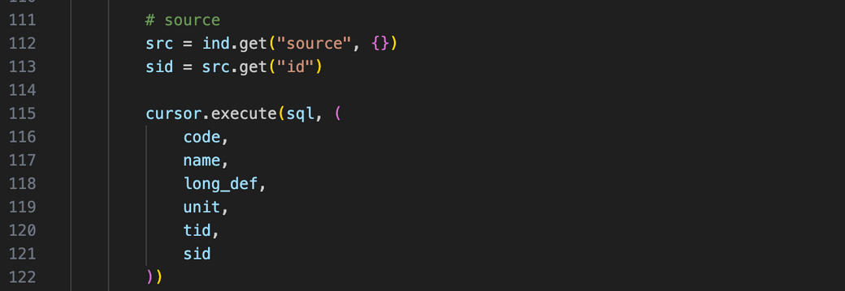
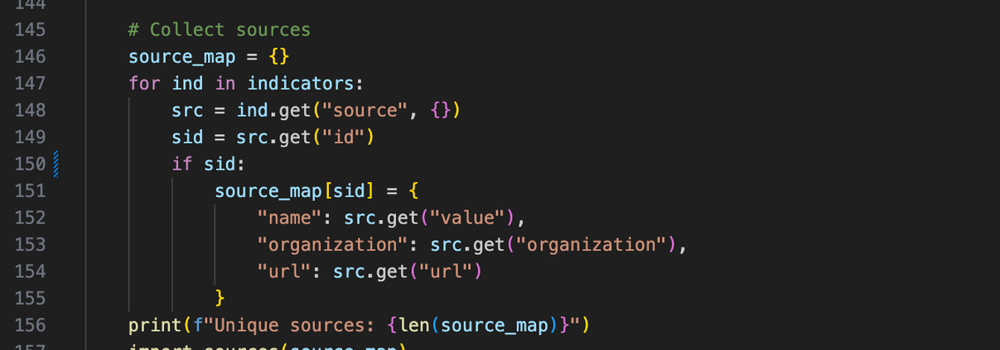
Normalization
ETL Approach: We used a Python script to Extract, Transform, and Load the data directly in 3NF structure.
In-Memory De-duplication:
Utilized Python dictionaries (source_map) to identify and filter unique entries before database insertion.
Prevents duplicate records in Sources and Categories tables.
Foreign Key Association:
The script retrieves the unique ID of the source/category.
Inserts only this Foreign Key (sid) into the main Indicators table, ensuring data integrity.

Slide 9
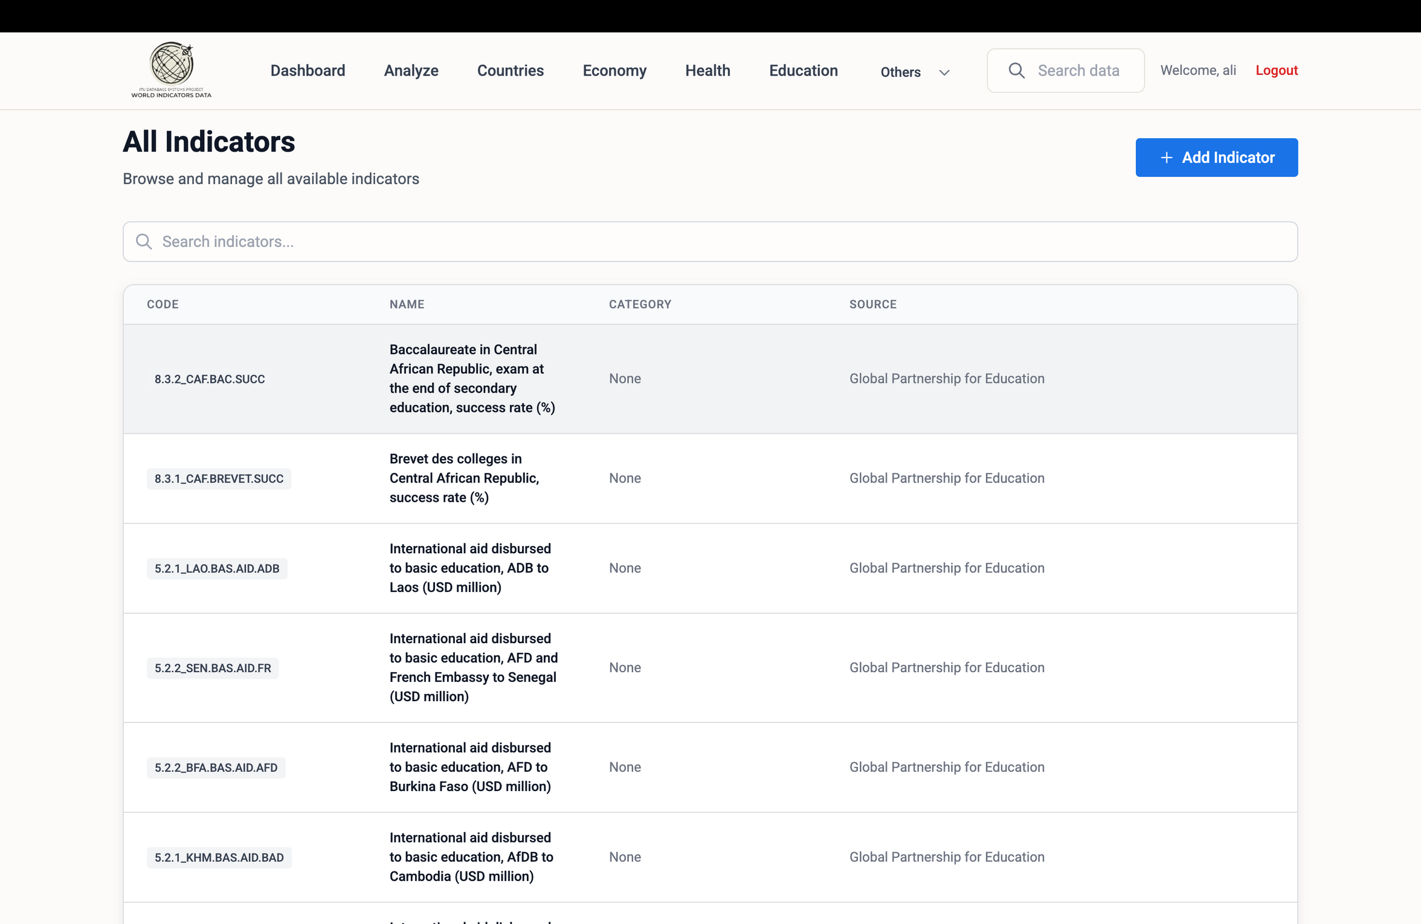
After Normalization
Structured Data: The complex, nested JSON objects are now stored in relational tables (Indicators, Sources, Categories).
Reference-Based Storage: The "Source" column is no longer a repeated text block. It is a Foreign Key reference to the Sources table.
3NF Compliance:
Transitive Dependencies Removed: Source details (organization name, description) are separated from the Indicator data.
Update Anomalies Eliminated: Updating a source's name in the Sources table automatically updates it for all associated indicators.

Slide 10
Dataset Description
What does the data include?: The dataset comprises time-series development metrics categorized into three core domains: Economy, Health, and Education. It covers global data for countries and regions, including variables such as GDP, Population, Life Expectancy, and School Enrollment rates.
What is the source?: The primary source is the World Development Indicators (WDI) database managed by the World Bank. We utilized the official WDI API and bulk CSV exports to ensure data accuracy and reliability.
How large is it?: The database contains 19962 rows, covering information about 211 countries.

Slide 11
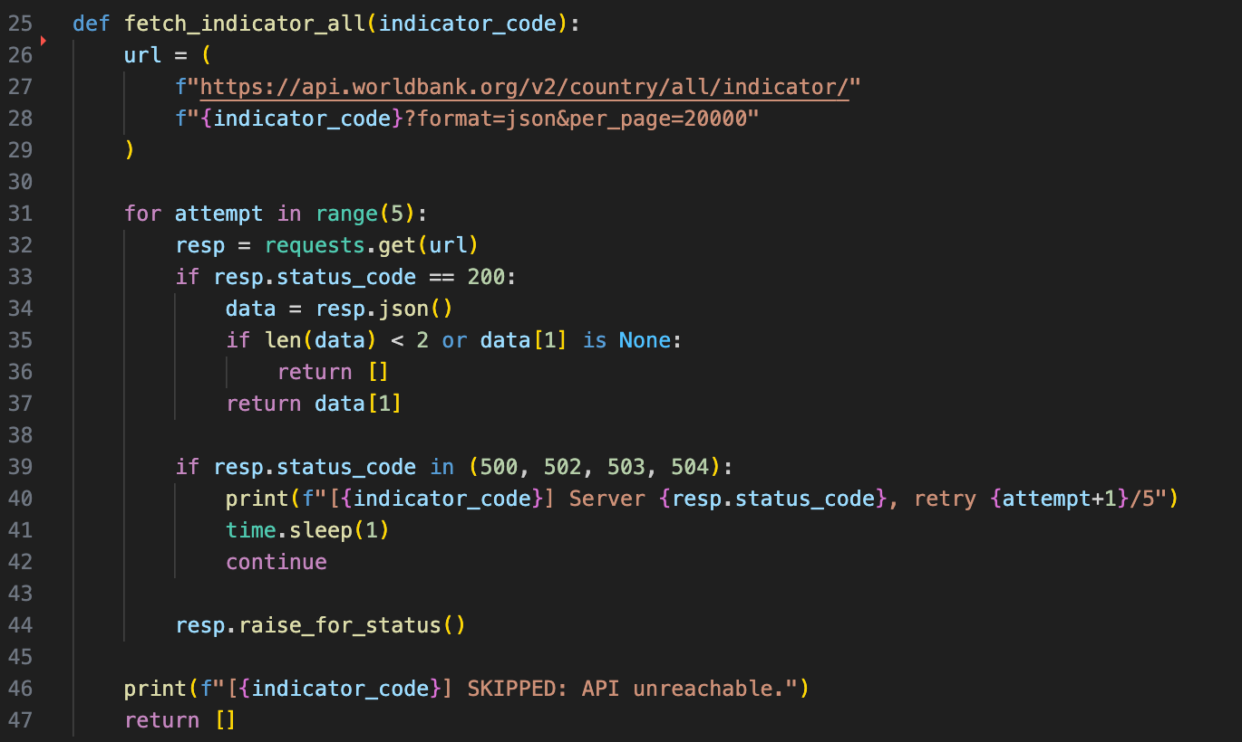
Data Fetching

Slide 12
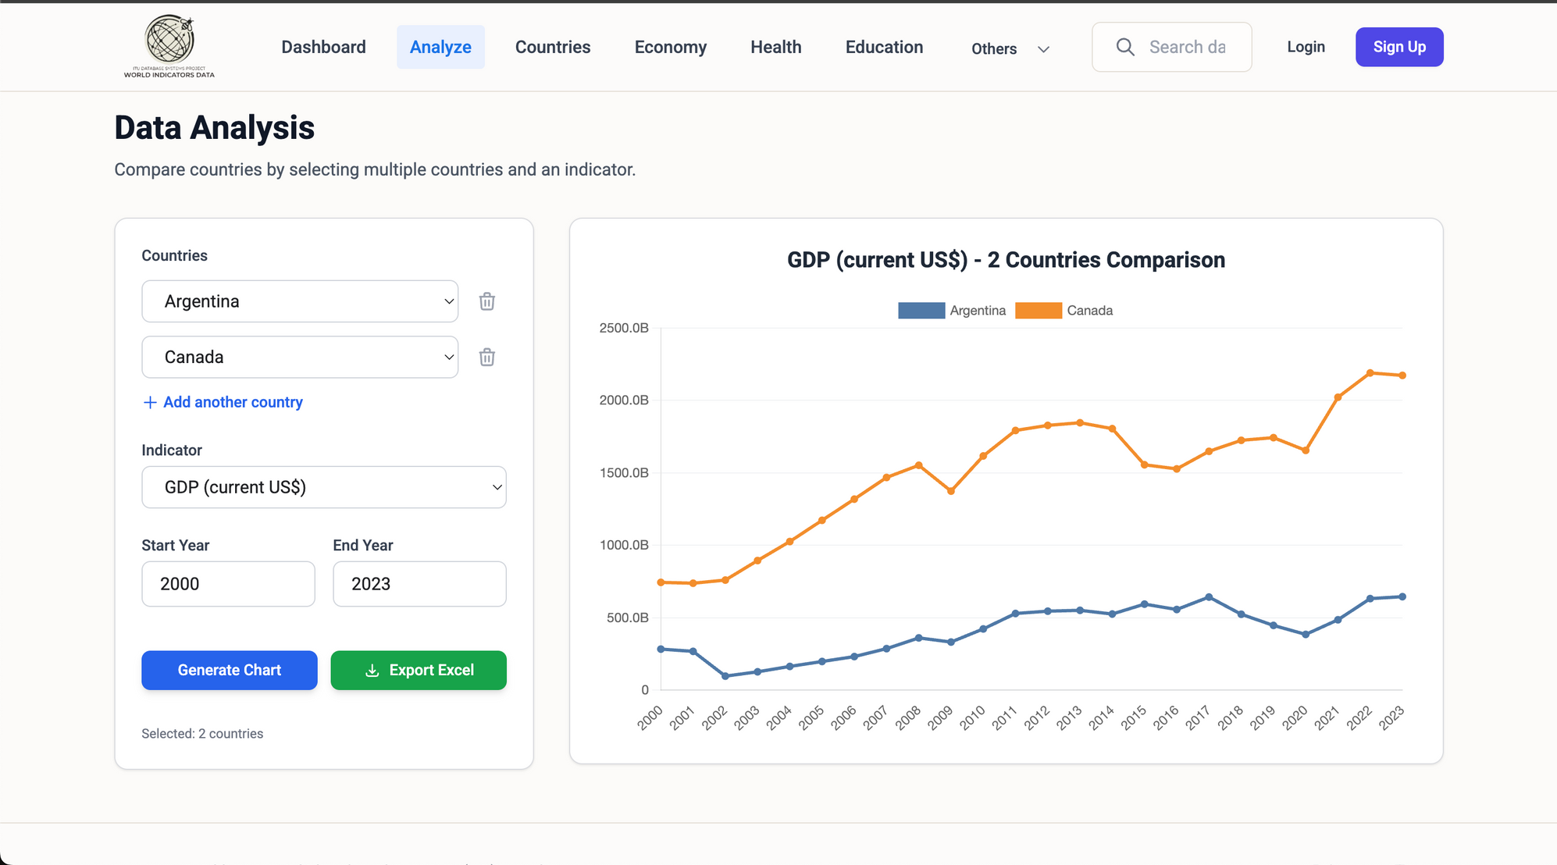
Compare Countries

Slide 13
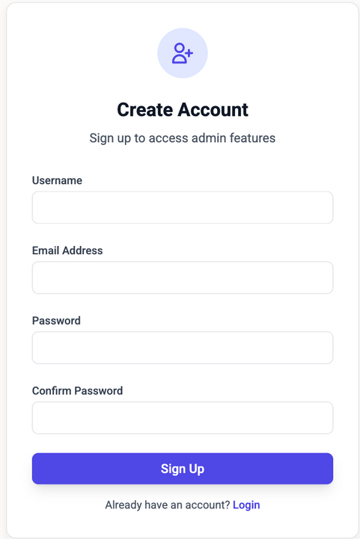
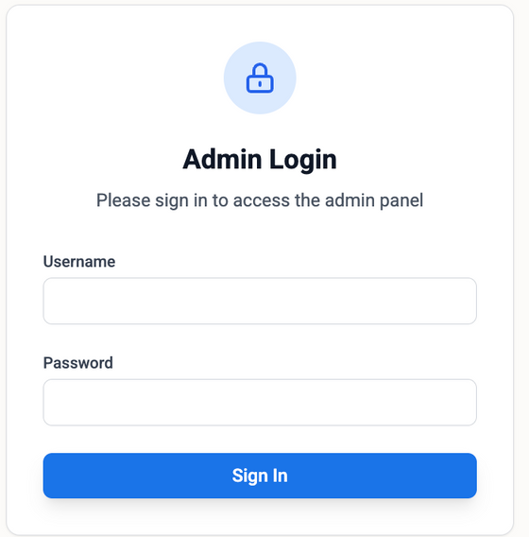
Sign Up and Log In

Slide 14
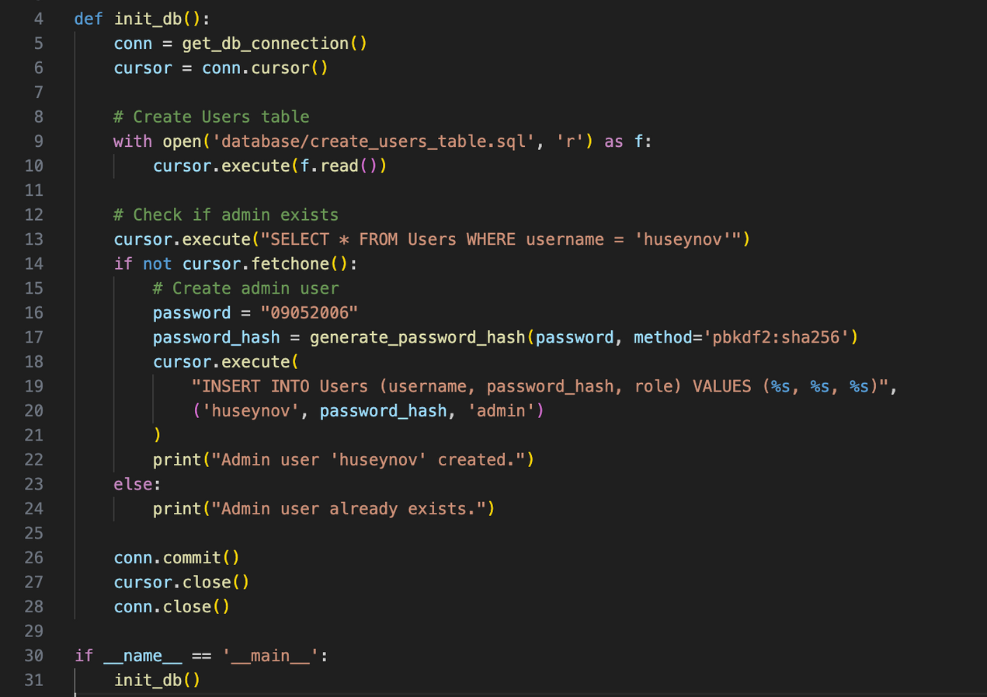

Slide 15
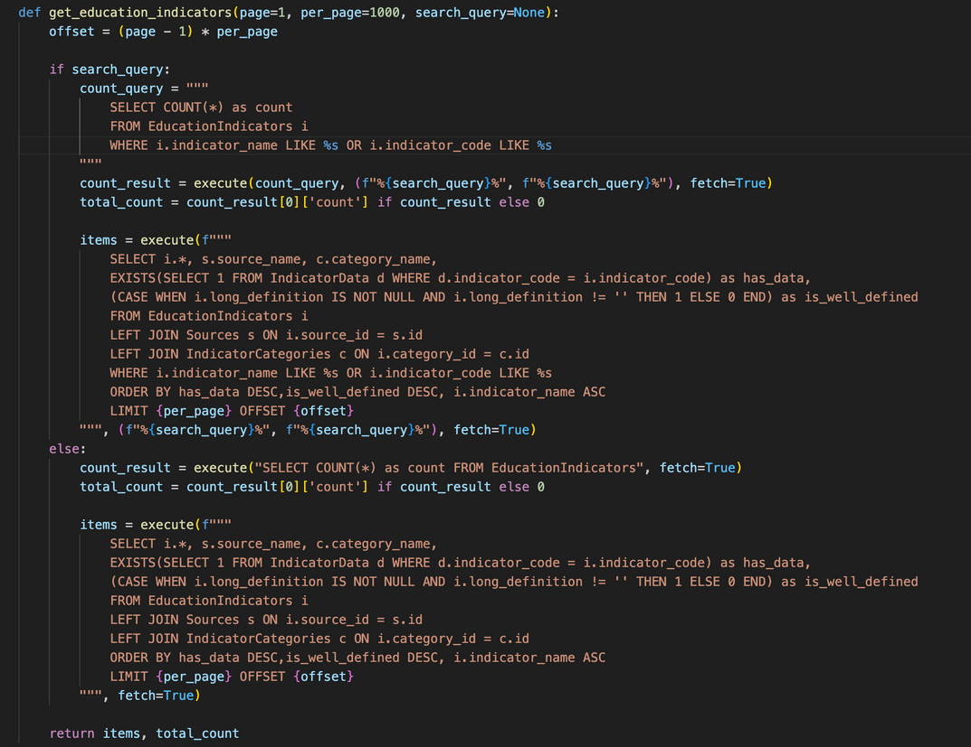
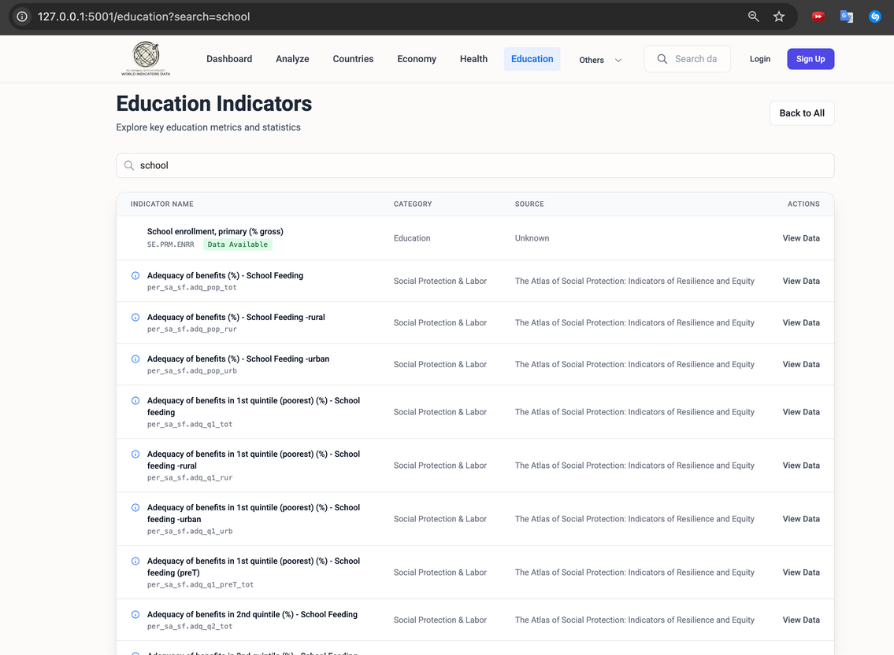
Complex Queries

Slide 16
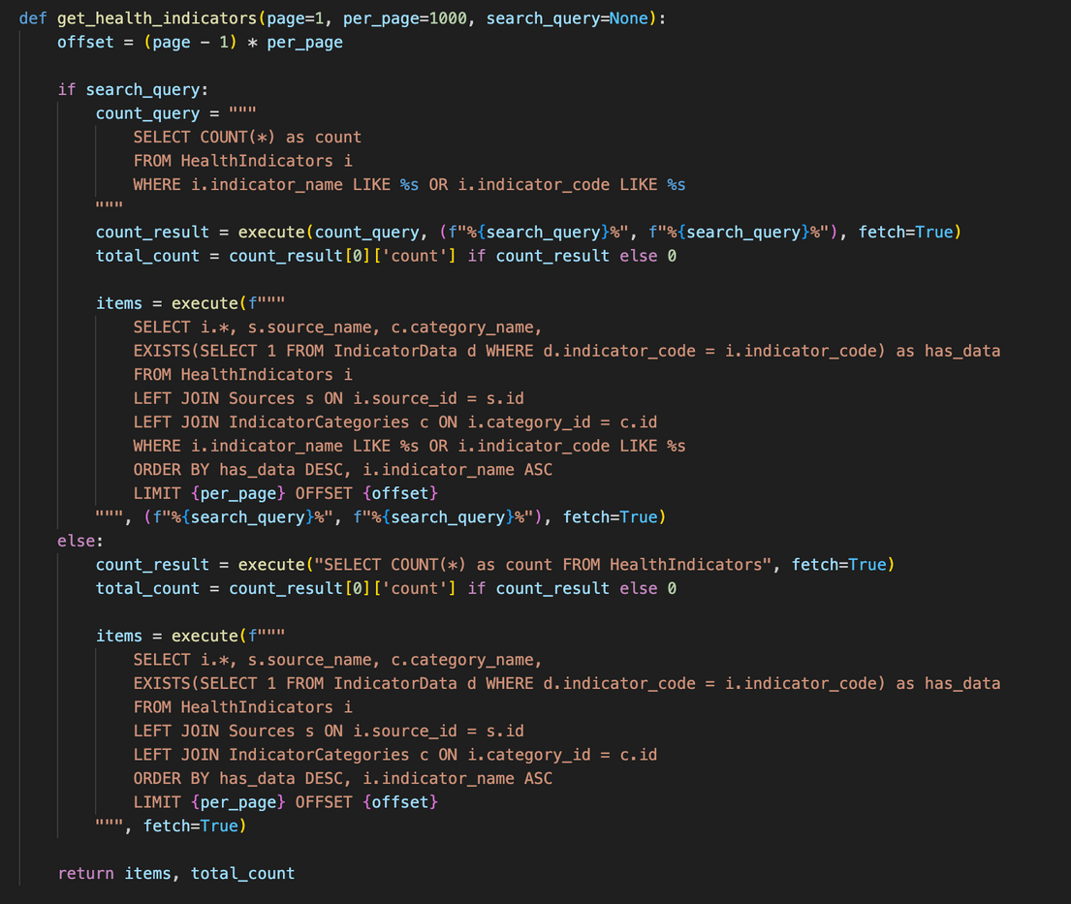
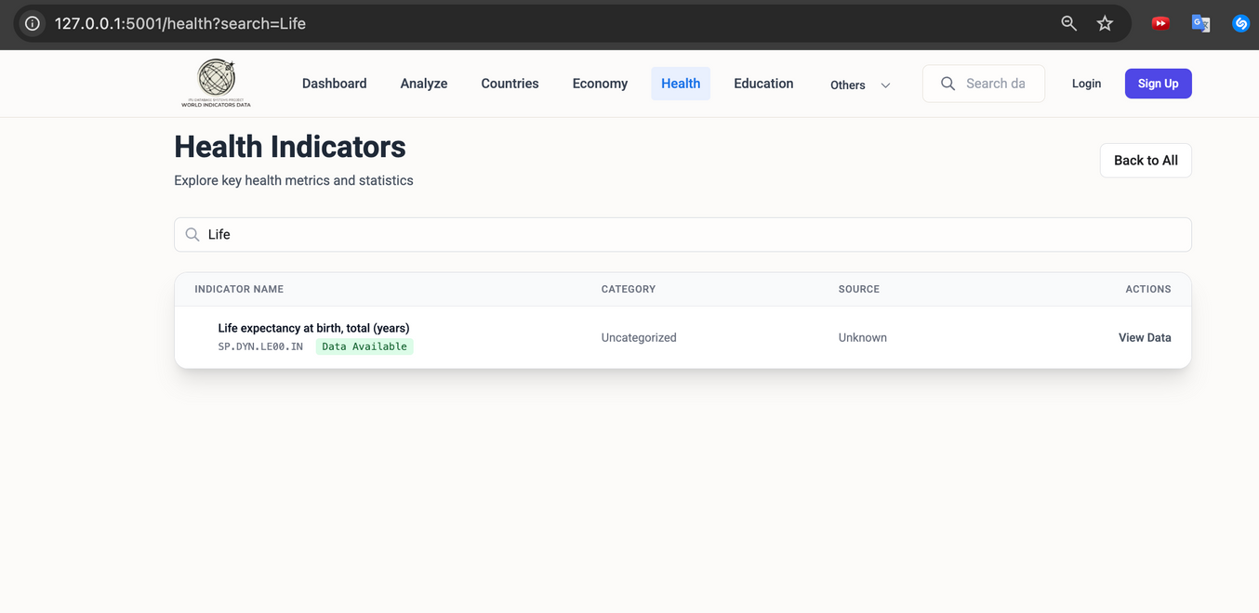
Complex Queries

Slide 17

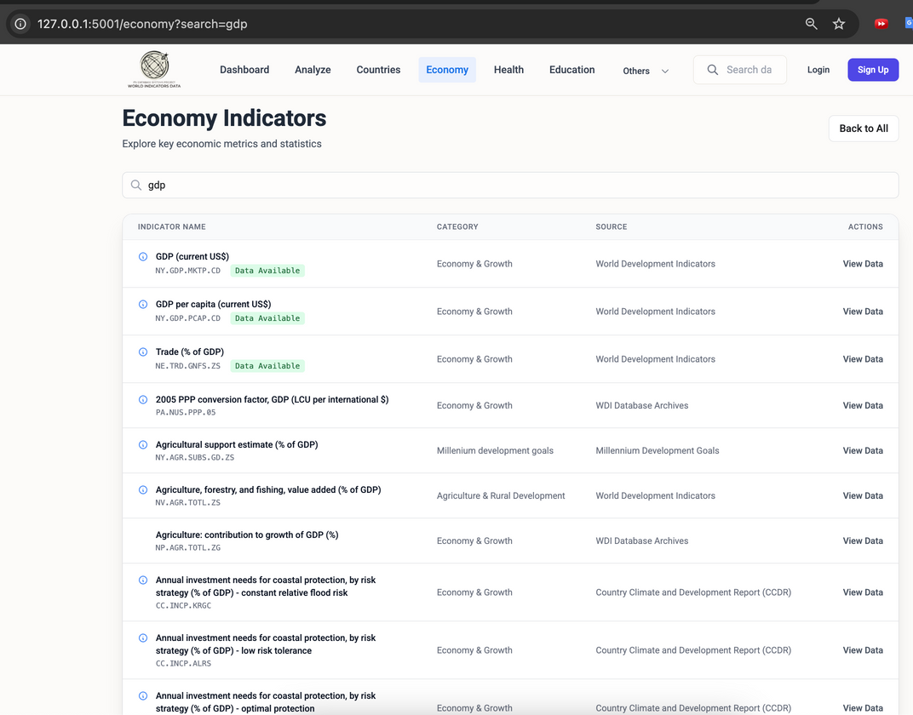
Complex Queries

Slide 18
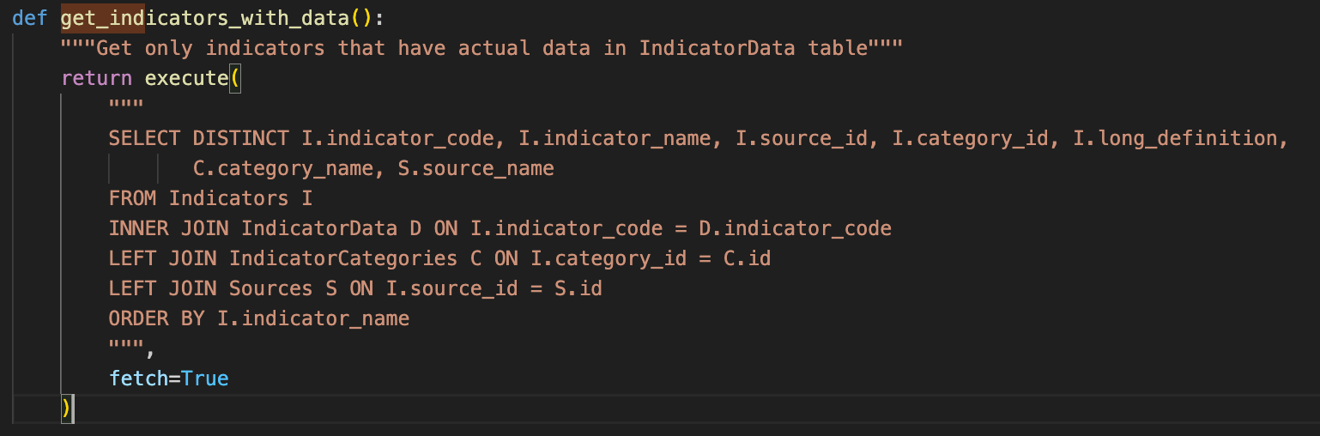
Complex Queries

Slide 19
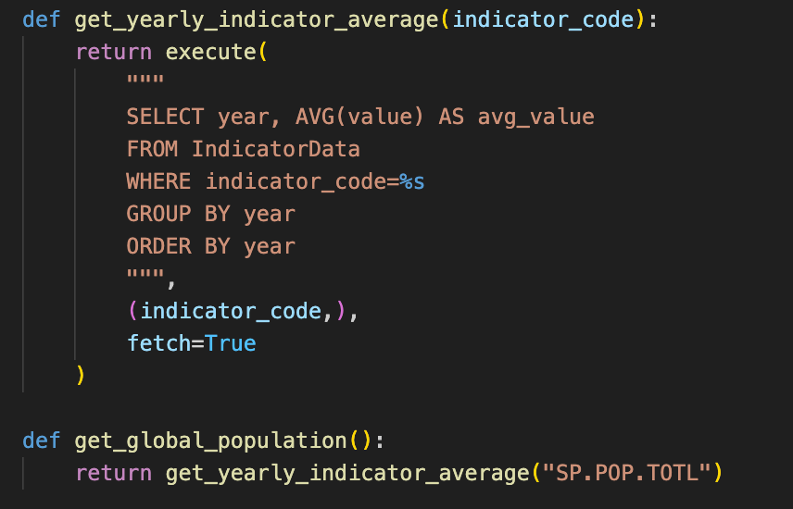
Complex Queries

Slide 20
Complex Queries

Slide 21
Delete Constraints
IndicatorData Table :
Countries: ON DELETE RESTRICT
Indicators: ON DELETE RESTRICT
EducationIndicators Table :
IndicatorCategories: ON DELETE CASCADE
Sources: ON DELETE RESTRICT
EconomyIndicators Table :
IndicatorCategories: ON DELETE RESTRICT
Sources: ON DELETE RESTRICT
Health Indicators Table :
IndicatorCategories: ON DELETE CASCADE
Sources: ON DELETE RESTRICT
Countries Table :
Regions: ON DELETE RESTRICT

Slide 22
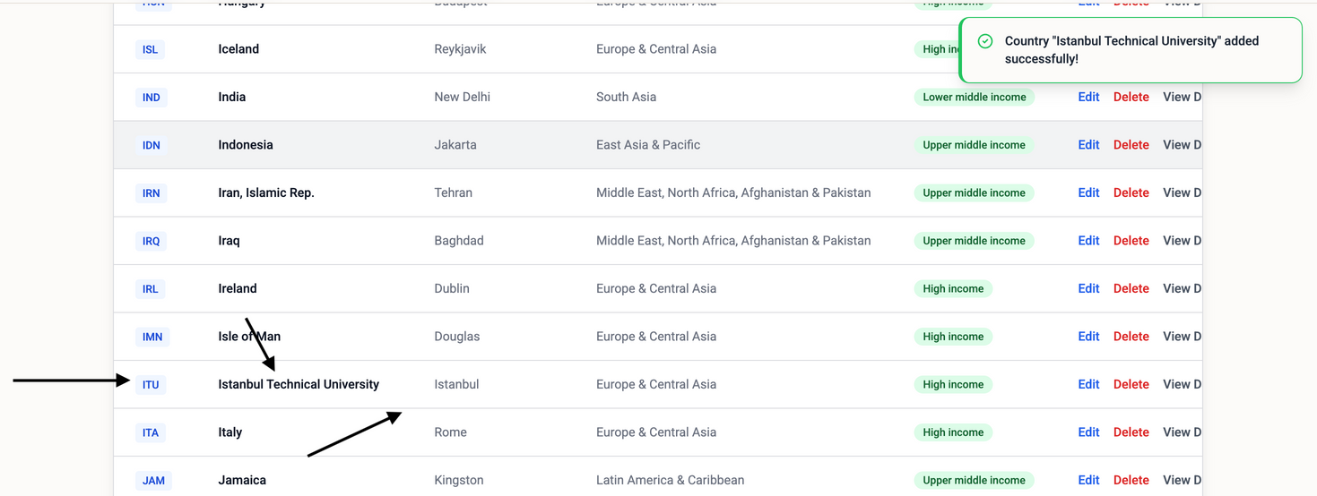
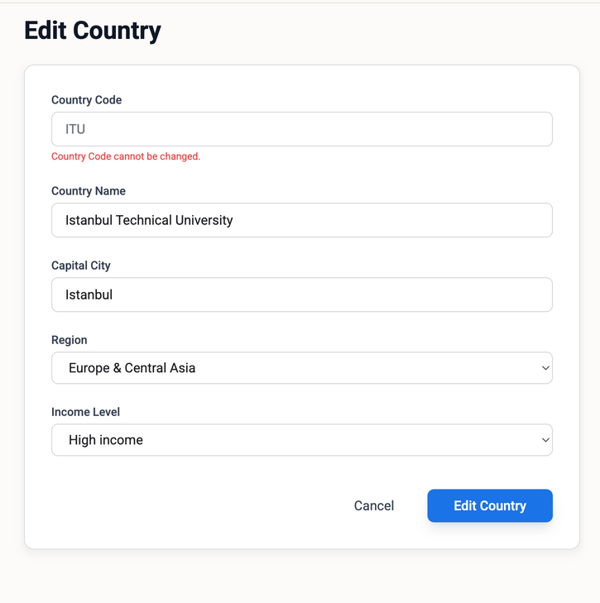
Testing
“Since this is a data-driven application with limited user interaction, our testing mainly focused on validating imported data, enforcing admin-only CRUD operations, and ensuring database integrity.”

Slide 23


Thank you for your attention!

